Slide 2
29 PIECES USES ART TO:
Awaken,
uplift,
give voice to
the creative human spirit
to make genuine, positive, social change
ARTISTS MAKING A KINDER WORLD

Slide 3
Recognizing the love of place and people
Brought to you by
ARTISTS MAKING A KINDER WORLD

Slide 4
Sometimes it helps to look at a chart like this to even know what we are feeling.
OBJECTIVES OF THE NORTHWEST ARKANSAS LOVE PROJECT
1. LEARN HISTORY of the Dallas and American LOVE Projects.
2. UNDERSTAND the meanings of the word LOVE.
3. APPRECIATE the special nature of NW Arkansas.
4. FEEL COMPASSION and EMPATHY about the issues we face in today’s world. 5. GET INSPIRED about the power of art to ignite positive social change. 7. CREATE and SHARE your art and your message of LOVE in exhibits in your community.
ARTISTS MAKING A KINDER WORLD

Slide 5
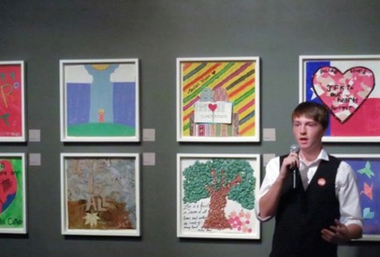
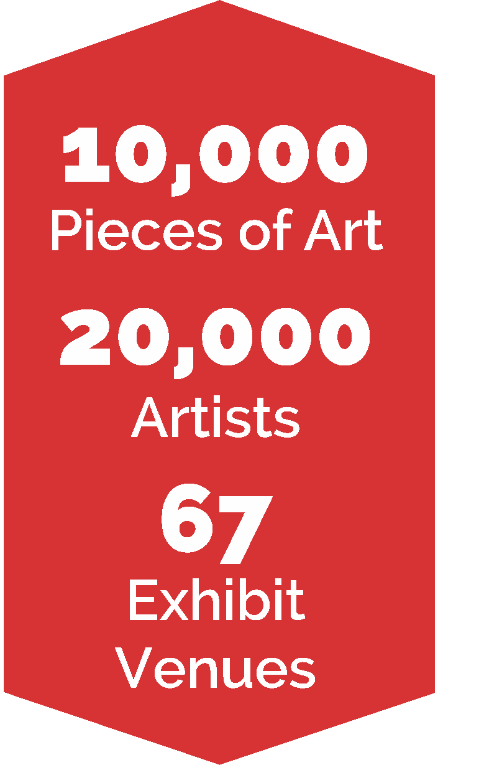
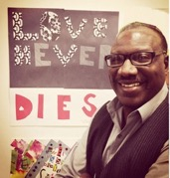
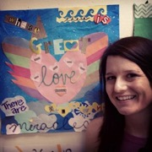
29 Pieces conceived the Dallas LOVE Project to honor the legacy of President John F. Kennedy. Following the president’s assassination in 1963, Dallas was labeled by some as a “City of Hate.”
In 2013, through the Dallas LOVE Project, 29 Pieces brought artists together to express the idea that Dallas is a city where LOVE thrives.
ARTISTS MAKING A KINDER WORLD

Slide 6
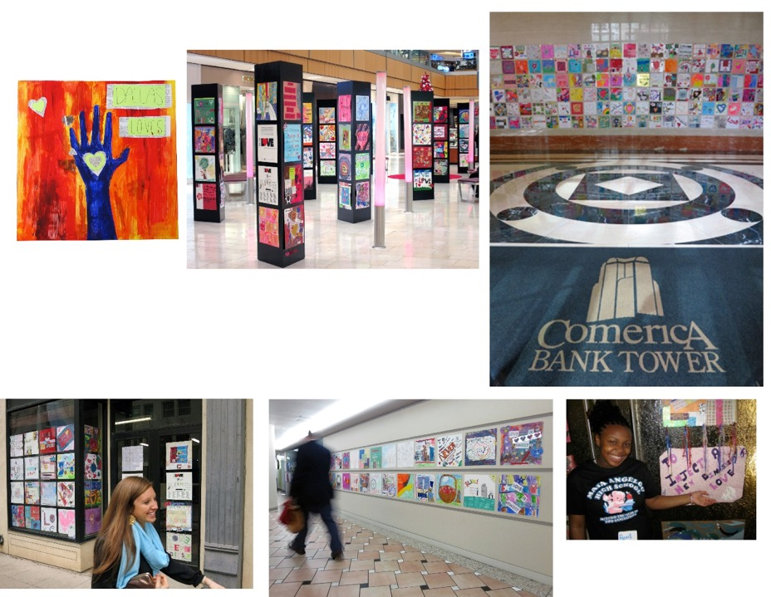
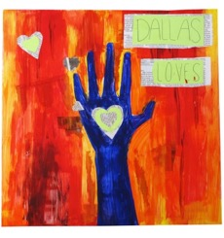
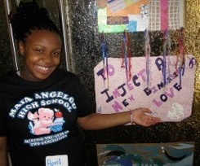
67 EXHIBIT VENUES
ARTISTS MAKING A KINDER WORLD

Slide 7
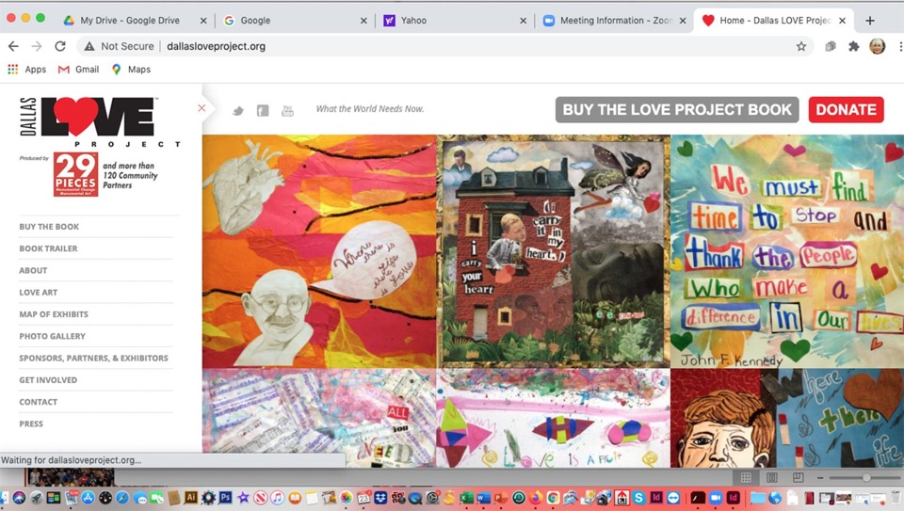
ONLINE Gallery: Dallas LOVE Project. Dallasloveproject.org
ARTISTS MAKING A KINDER WORLD

Slide 8
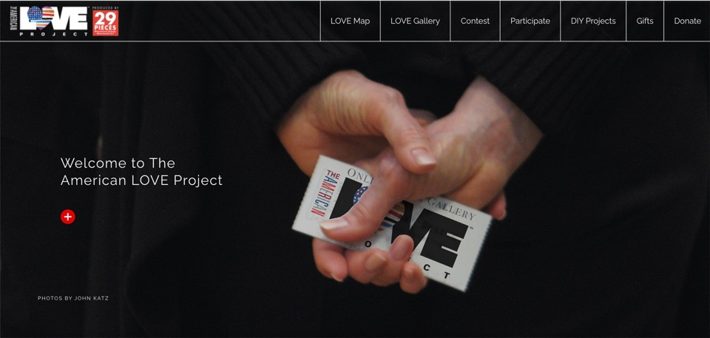
2021. The American LOVE Project was a nation-wide project to use art to heal and find unity in our country. ONLINE Gallery: Theamericanloveproject.org
ARTISTS MAKING A KINDER WORLD

Slide 9
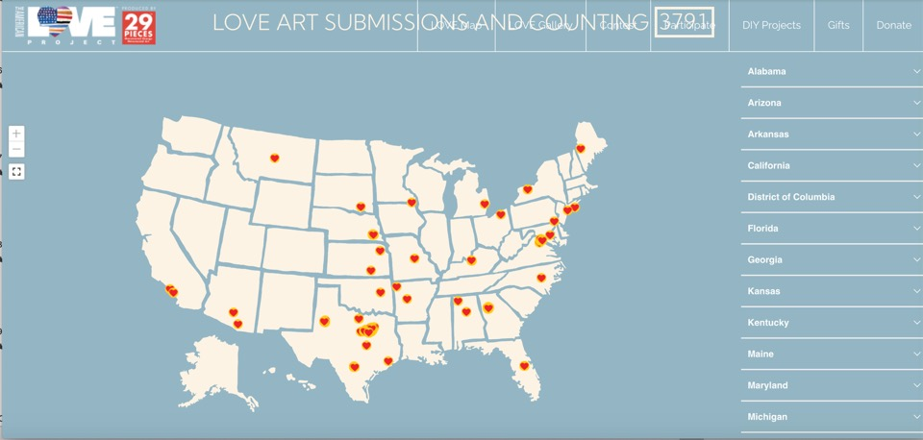
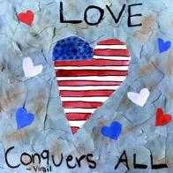
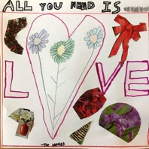
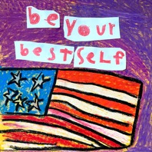
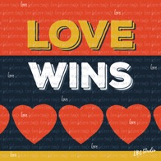
3791 ART SUBMISSIONS, from 24 STATES AND WASHINGTON DC.
ARTISTS MAKING A KINDER WORLD

Slide 10
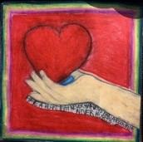
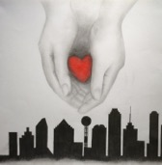
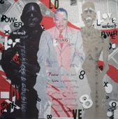
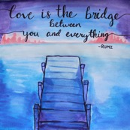
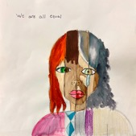
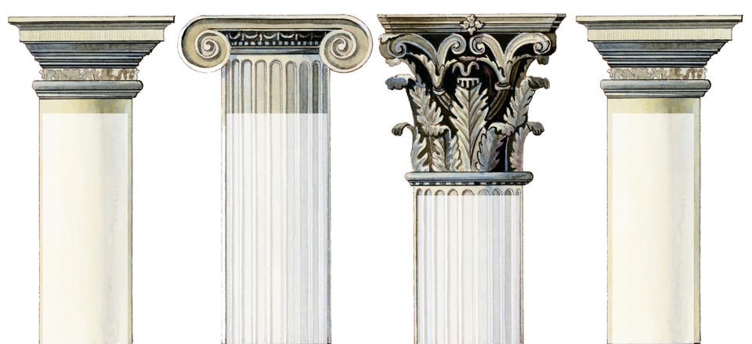
The Northwest Arkansas LOVE Project is built on four pillars.
1.
LOVE REPAIRS AND HEALS the divides that separate us and keep us from working together to solve urgent problems in our community and world.
2.
THE IDEALS represented in the beauty of the natural world, culture and people of Northwest Arkansas.
4.
WORDS OF A GREATER LOVE from great philosophers, artists, musicians, poets and peacemakers speak through time and remind us of the spark of love in each of us.
3.
ART HAS THE POWER to awaken and educate hearts, uplift our voices and make positive social change.
ARTISTS MAKING A KINDER WORLD

Slide 11
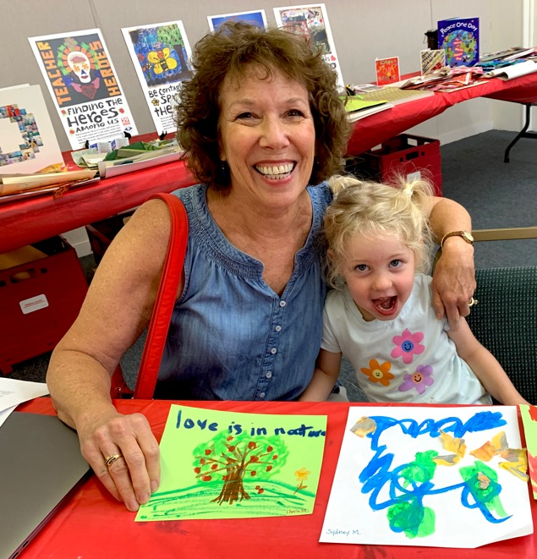
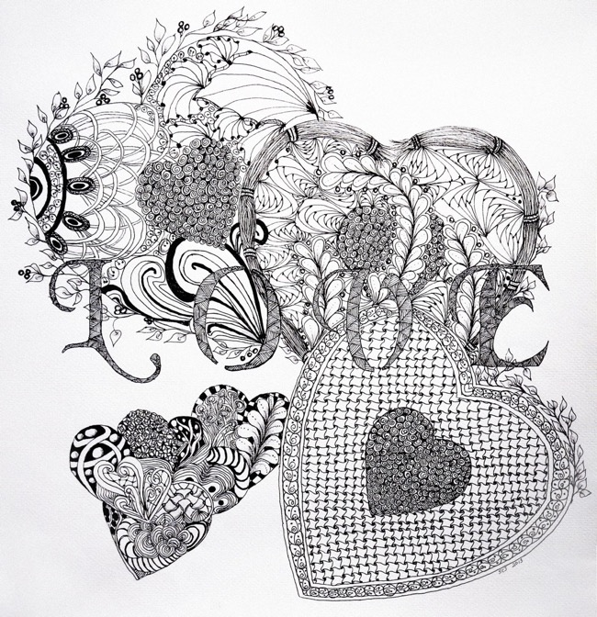
LOVE
1. FIRST PILLAR: LOVE Repairs and Heals
What does it mean to you?
ARTISTS MAKING A KINDER WORLD

Slide 12
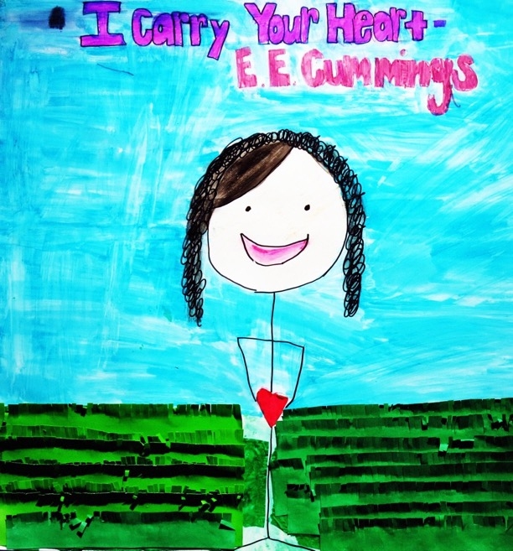
The dictionary meaning of LOVE:
A feeling of warm personal attachment or deep affection for someone or something. A virtue representing all of human kindness, compassion and affection.
ARTISTS MAKING A KINDER WORLD

Slide 13
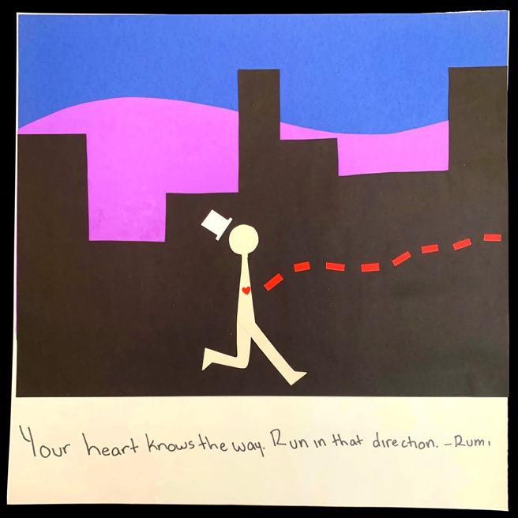
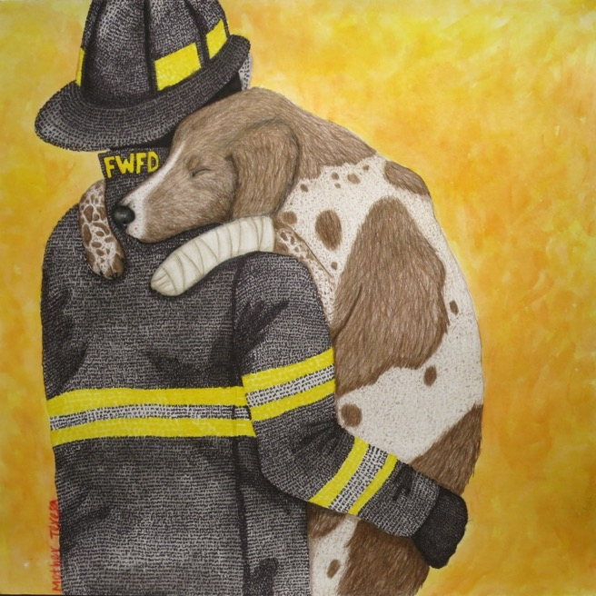
Sometimes it helps to look at a chart like this to even know what we are feeling.
But ancient cultures had 3 or more words to describe different kinds of LOVE.
Here are 3 words the Greeks used.
Agápe: Unconditional love for one another. To will good for others.
Éros: intimate or romantic love.
Philia: friendship, usually between equals.
ARTISTS MAKING A KINDER WORLD

Slide 14
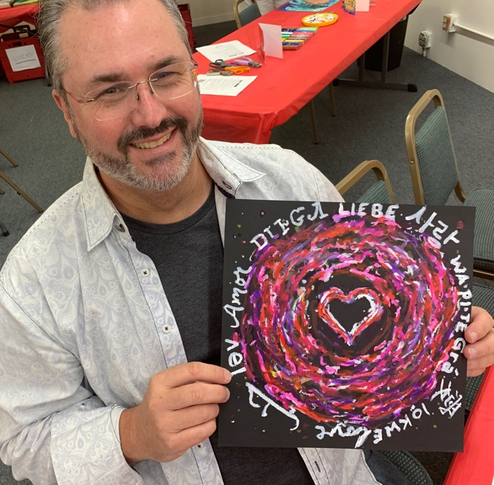
For the NW Arkansas LOVE Project, we’ll make art focused on AGAPE, the bigger kind of LOVE.
ARTISTS MAKING A KINDER WORLD

Slide 15
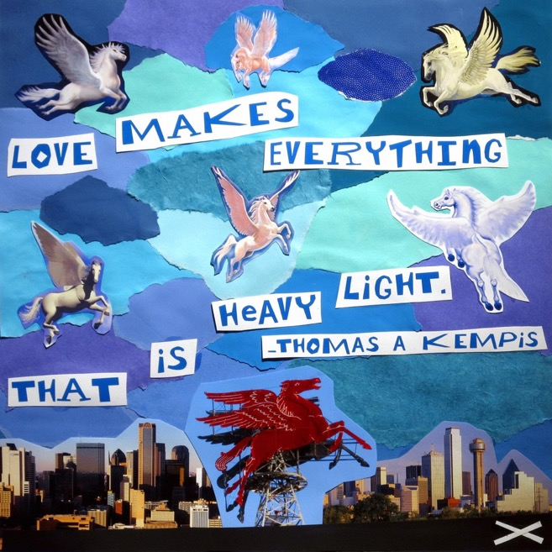
We’ll use quotes about this bigger LOVE from great artists, peacemakers, musicians, and writers.
We ask you to use one of their quotes for the subject of your art.
ARTISTS MAKING A KINDER WORLD
Notes:
Why are we asking you to use these quotes from great peacemakers, artists, musicians, poets, writers, scientists? Because //////

Slide 16
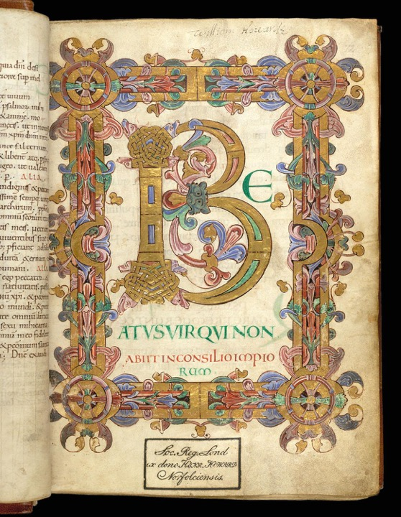
We’ll learn how letters can be decorated and become works of art.
ARTISTS MAKING A KINDER WORLD

Slide 17
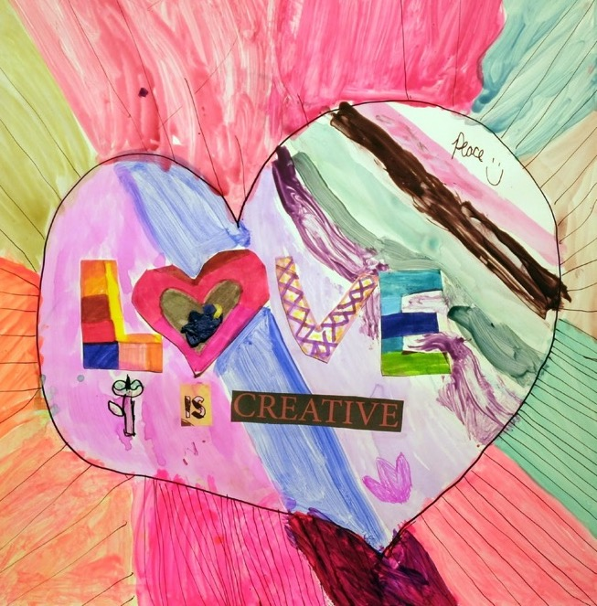
Then we ask you to create your message of LOVE.
ARTISTS MAKING A KINDER WORLD
Notes:
We want to mention that we are not asking for traditionally patriotic messages. The art could be a plea for something better, or a reminder that the work is not finished.

Slide 18
There are so many things we can think of that we love about Northwest Arkansas!
2. SECOND PILLAR: THE IDEALS represented in the beauty of the natural world, culture and people of Northwest Arkansas.
ARTISTS MAKING A KINDER WORLD

Slide 19
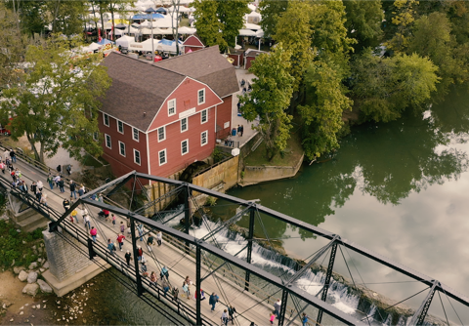
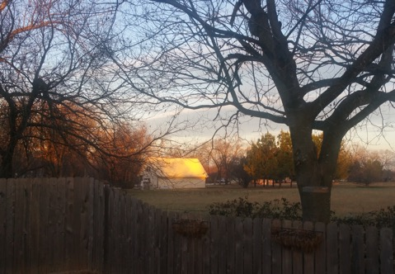
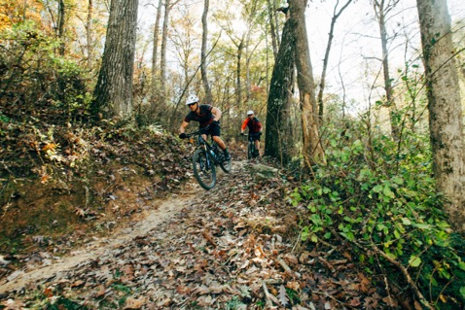
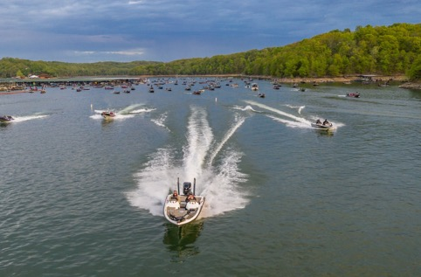
Natural beauty surrounds us
ARTISTS MAKING A KINDER WORLD

Slide 20
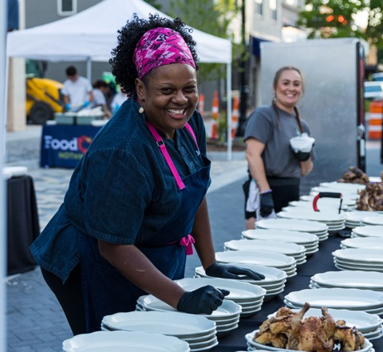
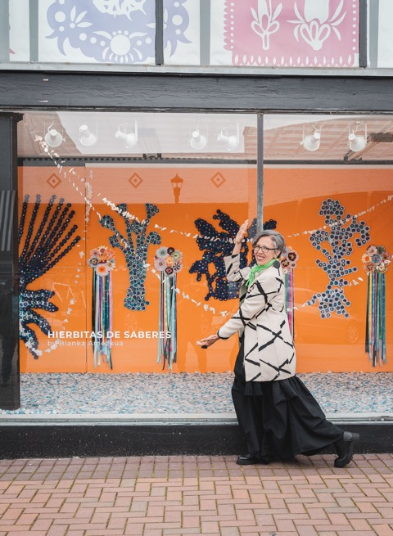
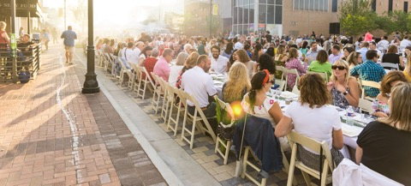
We celebrate one another.
ARTISTS MAKING A KINDER WORLD

Slide 21
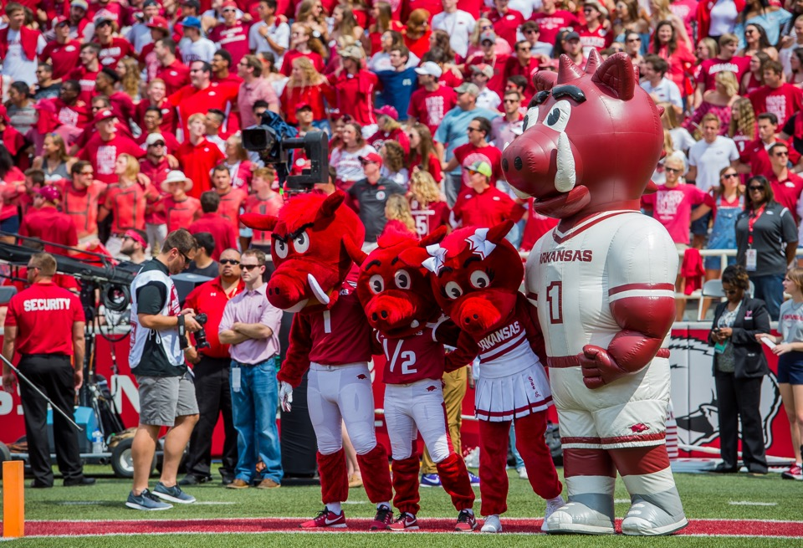
Arkansas Razorback’s Spirit!!
ARTISTS MAKING A KINDER WORLD

Slide 22
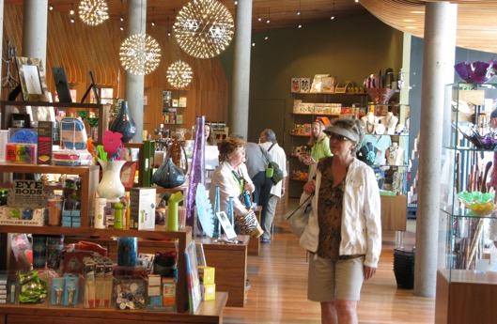
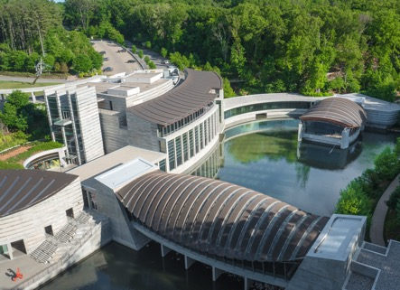
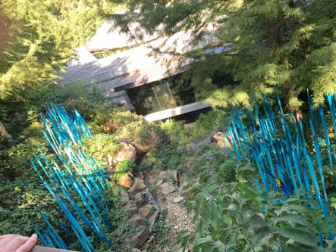
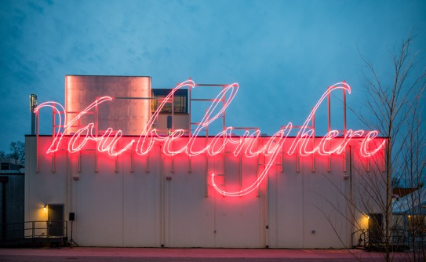
People come from across the globe to visit our museums
You belong here by artist Tevares Strachan
ARTISTS MAKING A KINDER WORLD

Slide 23
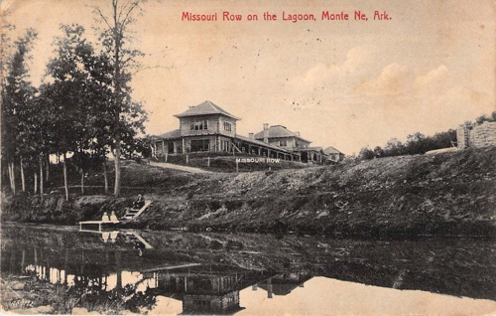
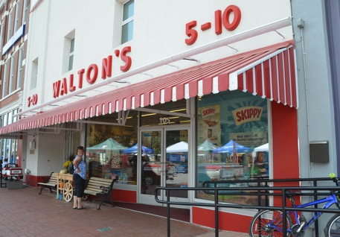
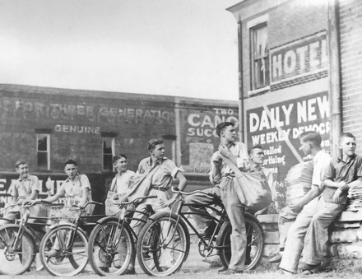
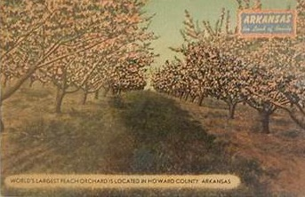
We have a shared history.
ARTISTS MAKING A KINDER WORLD

Slide 24
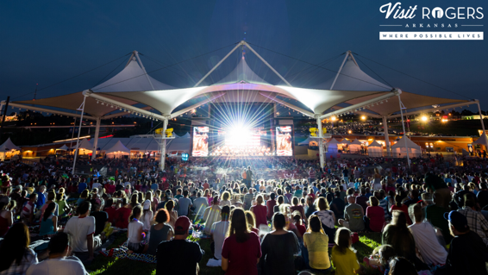
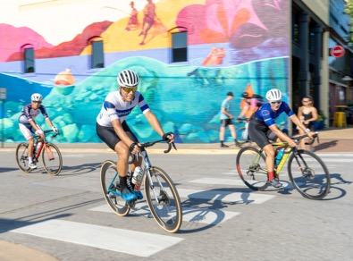
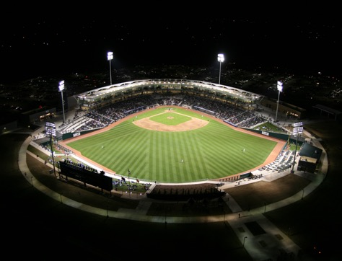
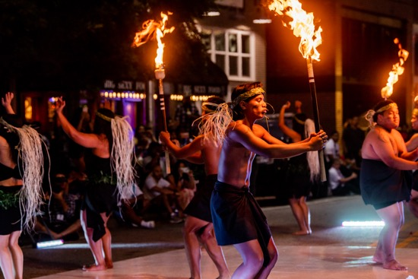
There’s just so much to do here!
ARTISTS MAKING A KINDER WORLD

Slide 25
What places do you love in Northwest Arkansas? What do you love about the people in your community?
ARTISTS MAKING A KINDER WORLD

Slide 26
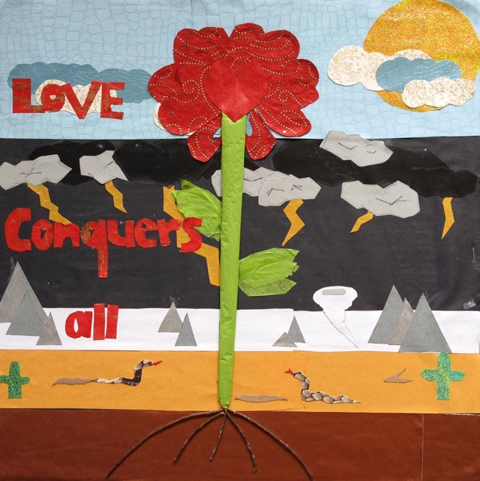
ART IS OUR STRATEGY TO OPEN HEARTS, AND TO EXPRESS AND GIVE LOVE.
3. THIRD PILLAR: The POWER OF ART TO REPAIR AND HEAL
ARTISTS MAKING A KINDER WORLD

Slide 27
How can we – as artists - work together and do even more to build our community and a world that shows more LOVE?
ARTISTS MAKING A KINDER WORLD

Slide 28
Frederick Douglass plants the seed of how we can begin to think about using art to act and channel our powers: “Poets, prophets and reformers are all picture makers—and this ability is the secret of their power and of their achievements. They see what ought to be by the reflection of what is, and endeavor to remove the contradiction.” — Frederick Douglass (1817-1895), abolitionist, orator, newspaper publisher, from his Lecture on Pictures, delivered in 1861
ARTISTS MAKING A KINDER WORLD

Slide 29
Here are artists who inspire us.
ARTISTS MAKING A KINDER WORLD

Slide 30
Ai Weiwei is a Chinese multi-media artist and political activist.
He has become a symbol for human rights in China.
“It is an artist’s duty to be a part of the social change and to create work that responds to the change.” — Ai Weiwei, artist
ARTISTS MAKING A KINDER WORLD
Notes:
Ai Weiwei is a famous living Chinese artist. Through his art, he calls attention to human rights violations. His work deals with moral and social consciousness.

Slide 31
JAUNE QUICK-TO-SEE-SMITH, (Confederated Salish and Kootenai Nation) “Trade (Gifts for Trading Land with White People)” 1992. She combines appropriated imagery from commercial slogans and signage, art history and personal narratives to create a visual language for her socio-political commentary. Her work draws from a Native worldview and comments on American Indian identity, histories of oppression, and environmental issues.
ARTISTS MAKING A KINDER WORLD

Slide 32
ELIZABETH CATLETT, (1915 - 2012), American and Mexican graphic artist and sculptor, is best known for her depictions of African American experience in the 20th century, giving voice to the enduring dignity and strength of Black women and men. She expanded the idea of what is “acceptable subject matter” in art by exploring the personal and political.
ARTISTS MAKING A KINDER WORLD

Slide 33
KERRY JAMES MARSHALL explores issues of identity and African-American history in his paintings.
ARTISTS MAKING A KINDER WORLD

Slide 34
CORITA (1918-1986) was an artist, educator and advocate for social justice who used pop art imagery, poetry and cultural quotes to create messages of hope.
ARTISTS MAKING A KINDER WORLD

Slide 35
SHEPARD FAIREY, “We the People” 2017. Posters created highlighting Black, Muslim and Latina women for the 2017 inauguration and women’s march.
ARTISTS MAKING A KINDER WORLD
Notes:
How can men and women find a balance and work together?

Slide 36
YOLANDA LOPEZ, “Portrait of the Artist as the Virgin of Guadalupe” 1978.
Lopez explores and reimagines representations of women within Chicano/a/x culture and society at large.
ARTISTS MAKING A KINDER WORLD

Slide 37
GUERILLA GIRLS are anonymous feminist activist artists.
They wear gorilla masks in public and use facts, humor and outrageous visuals to expose gender and ethnic bias. They call themselves the conscience of the art world.
ARTISTS MAKING A KINDER WORLD

Slide 38
Judy and Karen think about transition here. Now - to prepare for MAKING AMERICAN LOVE PROJECT ART, let’s reflect on YOUR thoughts on LOVE.
ARTISTS MAKING A KINDER WORLD

Slide 39
How have you used the word LOVE in the last few days?
ARTISTS MAKING A KINDER WORLD

Slide 40
LOVE
For the Northwest Arkansas LOVE Project, we are talking about AGAPE LOVE.
Remind us what that is.
ARTISTS MAKING A KINDER WORLD

Slide 41
1. What are some of the emotions we feel when we have love in our heart?
2. What are some ways that you can show LOVE?
ARTISTS MAKING A KINDER WORLD

Slide 42
This BIGGER LOVE is more than just what we sense with our eyes or tummy. We’re talking about the LOVE we feel in our hearts and want to share with others.
ARTISTS MAKING A KINDER WORLD

Slide 43
The BIG LOVE might be for our pets.
ARTISTS MAKING A KINDER WORLD

Slide 44
Or the BIG LOVE might be for parents, siblings,
or friends.
ARTISTS MAKING A KINDER WORLD

Slide 45
The BIG LOVE might be for the world around us –the mountains, the woods, the sky, the earth, the environment, our country.
ARTISTS MAKING A KINDER WORLD

Slide 46
We ask you to use a quote in your art from the list we are providing you. Here are some thoughts about LOVE from a great artist, musician, peacemaker, and poet.
4th PILLAR: WORDS OF A GREATER LOVE THAT STAND THE TEST OF TIME
ARTISTS MAKING A KINDER WORLD

Slide 47
Vincent Van Gogh 1853-1890
Van Gogh is recognized as one of the greatest artists of all time.
ARTISTS MAKING A KINDER WORLD

Slide 48
“The more I think it over, the more I feel that there is nothing more truly artistic than to Love People.” — Vincent Van Gogh
ARTISTS MAKING A KINDER WORLD

Slide 49
Alicia Keys
Born 1981
Alicia Keys is an American singer, songwriter, record producer, pianist, and actress.
ARTISTS MAKING A KINDER WORLD

Slide 50
“Love will come find you just to remind you of who you are." — Alicia Keys
ARTISTS MAKING A KINDER WORLD

Slide 51
Mahatma Gandhi
1869-1948
Gandhi was a peaceful leader who used non-violence to lead the people of India to independence.
ARTISTS MAKING A KINDER WORLD

Slide 52
Gandhi said: “Where there is Love there is Life.” Question: What happens in life when there isn’t love?
ARTISTS MAKING A KINDER WORLD

Slide 53
Maya Angelou
1928-2014
Maya Angelou was an internationally known American poet, writer, and civil rights activist.
ARTISTS MAKING A KINDER WORLD

Slide 54
“Love recognizes no barriers. It jumps hurdles, leaps fences, penetrates walls to arrive at its destination, full of hope.”
— Maya Angelou
ARTISTS MAKING A KINDER WORLD

Slide 55
These quotes about LOVE from ancient and contemporary visionaries uplift us with their positive power.
ARTISTS MAKING A KINDER WORLD

Slide 56
Choose a quote from our list that inspires YOU. Your art will be on a square format. Plan a color combination that expresses your feelings.
ARTISTS MAKING A KINDER WORLD

Slide 57
The letters in the words of your quote are part of your art form. How can your letters be expressive?
ARTISTS MAKING A KINDER WORLD

Slide 58
GUIDELINES FOR YOU: Decorate letters with animal, plant, or abstract forms, as shown.
ARTISTS MAKING A KINDER WORLD
Notes:
Encourage the students to notice how the artists fill the negative space with scrolling vines, animals, floral ornamentation, and design elements

Slide 59
Cut letters out of magazines.
ARTISTS MAKING A KINDER WORLD

Slide 60
Make up your own cut paper alphabet!
ARTISTS MAKING A KINDER WORLD

Slide 61
Letters and decorative elements can be drawn in ink, colored pencils and markers.
ARTISTS MAKING A KINDER WORLD
Notes:
Confirm that students are really looking at this to identify the various elements in the letter forms.

Slide 62
Your art can be done digitally. This piece was created in Photoshop.
You can also use the free app Tayasui Sketches!
tayasui.com
ARTISTS MAKING A KINDER WORLD

Slide 63
USE YOUR HANDWRITING as a design element.
ARTISTS MAKING A KINDER WORLD

Slide 64
Select a quote about LOVE from the quotes by great peacemakers, visionaries, poets and musicians we’ve given you. Your art should be square.
Do a few small sketches with pencil to figure out how you will incorporate the quote into your design.
STEP ONE
ARTISTS MAKING A KINDER WORLD
Notes:
In our experience, we’ve often used 18 in .x 18 in poster board for the background for the LOVE Lesson. This project has been done successfully as collage art, or by using color markers, paint, or using ink pens.

Slide 65
Choose your SQUARE background paper and materials. Design your message of LOVE with a decorated quote about LOVE on it. It helps to plan how you will use the letters. Make your art!
STEP TWO
ARTISTS MAKING A KINDER WORLD
Notes:
In our experience, we’ve often used 18 in .x 18 in poster board for the background for the LOVE Lesson. This project has been done successfully as collage art, or by using color markers, paint, or using ink pens.

Slide 66
When finished, take time to share your art with your group or class.
STEP
THREE
ARTISTS MAKING A KINDER WORLD

Slide 67
Here is how to be involved in the Northwest Arkansas LOVE Project: Click on this QR Code for all the information you will need:
STEP FOUR:
ARTISTS MAKING A KINDER WORLD

Slide 68
ARTISTS MAKING A KINDER WORLD

Slide 69
TWO OPTIONAL SUPPLEMENTS 1. Social and Emotional learning
2. Additional Social Justice Artists
ARTISTS MAKING A KINDER WORLD

Slide 70
1. Social and Emotional learning
ARTISTS MAKING A KINDER WORLD

Slide 71
Here’s one of the most difficult challenges:
HOW CAN WE SHOW LOVE TO OURSELVES AND ONE ANOTHER NO MATTER HOW COMPLEX LIFE IS?
ARTISTS MAKING A KINDER WORLD

Slide 72
It helps to understand how to process complex feelings and emotions in our heart and mind and in others.
ARTISTS MAKING A KINDER WORLD

Slide 73
Charts like this help us figure out our feelings.
And there are counselors, teachers and friends we can talk to about our complex feelings.
Pick out a couple of emotions on this sheet and make faces with your neighbor.
ARTISTS MAKING A KINDER WORLD
Notes:
We will provide this document in print and digital format in the teacher toolkit for the LOVE Project.

Slide 74
Model good citizenship and demonstrate core values.
Before I leave for school, I greet my neighbors with a friendly “Hello” or Good Morning!”
If I see someone in need, I offer my help, even if they don’t ask for it.
I always say ‘Please’ if I ask to borrow something that doesn’t belong to me. And I say ‘Thank You’ when returning it to the owner.
ARTISTS MAKING A KINDER WORLD

Slide 75
PRACTICE LOVE AND KINDNESS STARTING WITH OURSELVES.
ARTISTS MAKING A KINDER WORLD
ARTISTS MAKING A KINDER WORLD

Slide 76
ARTISTS MAKING A KINDER WORLD

Slide 77
We can make a better world if we:
1. SUPPORT each other, so that we can all thrive.
2. ENCOURAGE people to BE LOVE.
3. SEE injustice and TAKE ACTION to have a positive impact on our nation.
ARTISTS MAKING A KINDER WORLD

Slide 78
Additional Social Justice Artists
ARTISTS MAKING A KINDER WORLD

Slide 79
Fritz Scholder (Luiseno, 1937-2005) was a painter, printmaker and educator. His work challenged stereotypical representations of Native Americans and he was extremely influential in shaping a more contemporary approach to capturing Native American experience. He raised critical questions about cultural identity and representation.
ARTISTS MAKING A KINDER WORLD

Slide 80
BEN SHAHN
1898-1969, “Welders, For Full Employment After the War,” 1944
Shahn was an artist and Harvard Art Professor who explored, with empathy and compassion, modern urban life, immigration and injustice.
ARTISTS MAKING A KINDER WORLD

Slide 81
The new documentary “CRIP CAMP: A DISABILITY REVOLUTION,” by Nicole Newman and James LeBrecht traces the beginnings of the Disability Rights Movement and the activists who fought for equal access and equal rights in jobs, education, transportation, and housing.
ARTISTS MAKING A KINDER WORLD

Slide 82
MAYA LIN, Vietnam Veterans Memorial, 1981–82. Washington, D.C.
The memorial created a new art form for shared memory, grief and reconciliation.
ARTISTS MAKING A KINDER WORLD

Slide 83
TYREE GUYTON, Detroit, Michigan, established The Heidelberg Project, to transform neighborhoods with public art and community gatherings and to create a living indoor/outdoor art museum.
ARTISTS MAKING A KINDER WORLD

Slide 84
American LOVE Project Samples and Installations
ARTISTS MAKING A KINDER WORLD

